Slide 1

Telecommunication Project
Group 3:
Shrinidhi
Shivanand
Sujatha
Raji
Shubham
Ahmed

Slide 2
Business Objective
Business Objective: Customer churn is a big problem for telecommunications companies. Indeed, their annual churn rates are usually higher than 10%. For that reason, they develop strategies to keep as many clients as possible. This is a classification project since the variable to be predicted is binary (churn or loyal customer). The goal here is to model churn probability, conditioned on the customer features.

Slide 3
About Dataset.
Each row corresponds to a client of a telecommunications company for whom it has collected information about the type of plan they have contracted, the minutes they have talked, or the charge they pay every month.
The data set includes the following variables: state, area code, account length, voice plan, voice messages, International (plan, minutes used, calls made and charge), Daytime (Minutes used, calls made and charge), Evening (Minutes used, calls made and charge) , Night (Minutes used, calls made and charge), customer calls, Churn (Target Feature).

Slide 4
Project Flow
Loading Dataset
Descriptive Analysis
Handling of null values
Feature Selection
Outlier Handling
Data Preprocessing

Slide 5
Project Flow (Continued)
Model Building
Model Evaluation
Deployment

Slide 6
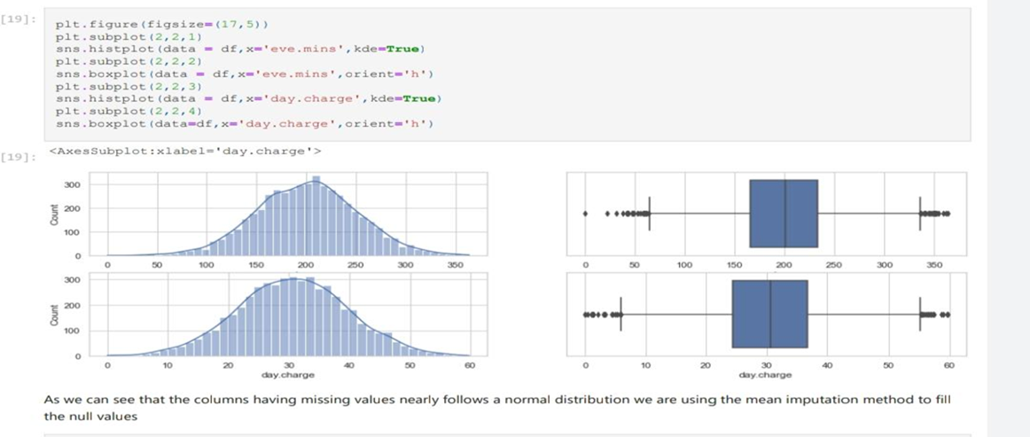
Null Value Imputation:
We have use imputation by mean for the null values as the feature nearly follows normal distribution

Slide 7
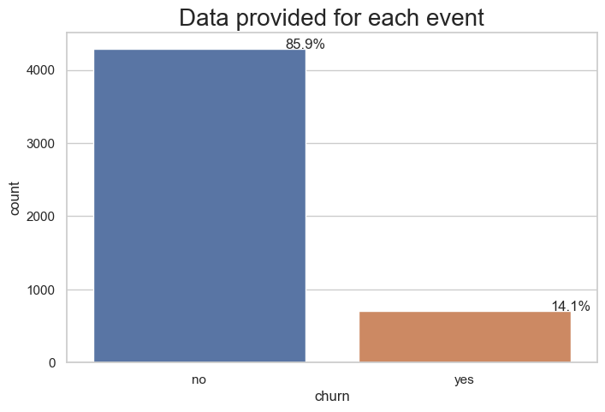
Visualizations and insights
As we can see the total churn rate of the customers is 14.1%

Slide 8
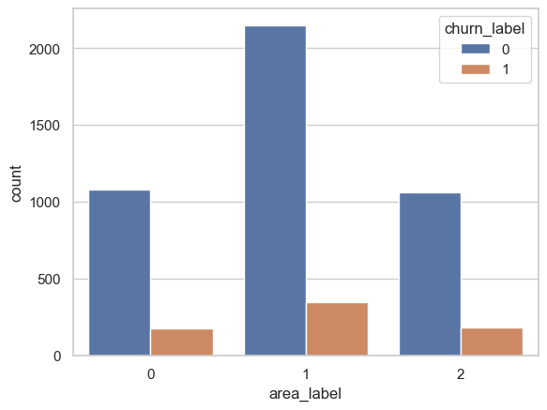
Area code 510 has highest churn rate compared to other area codes.

Slide 9
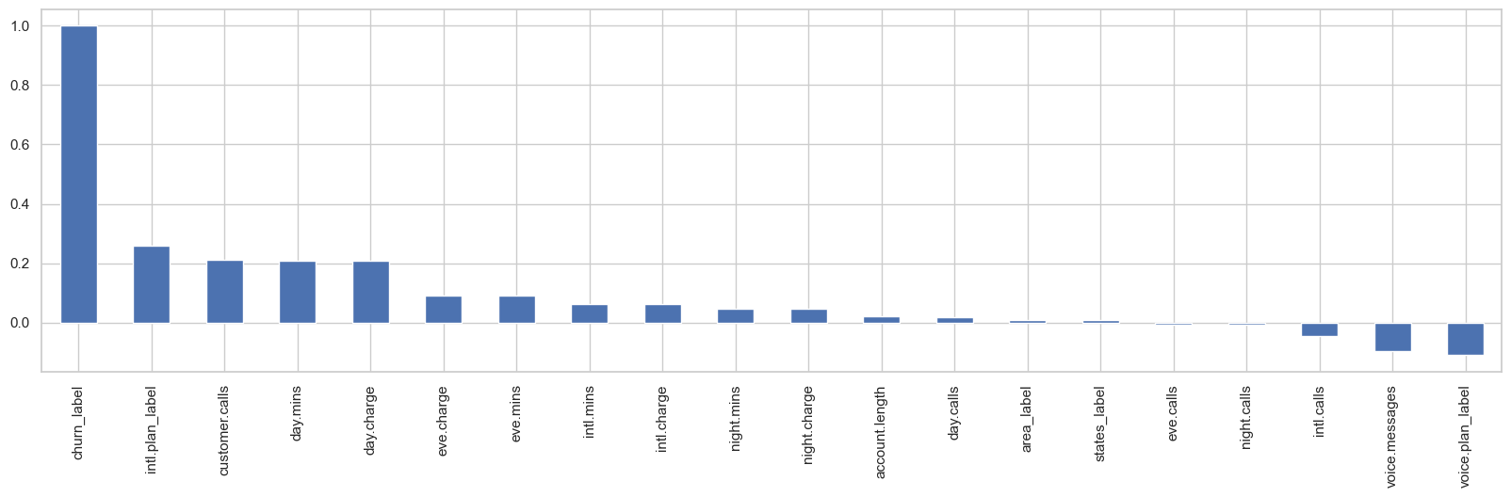
Here is the correlation of other features with our target feature.

Slide 10
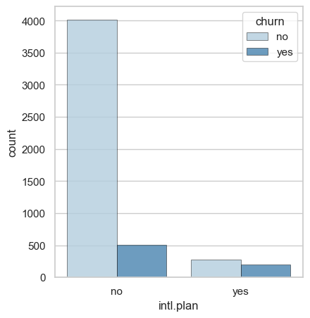
High ratio of customers with an international plan leaves the company

Slide 11
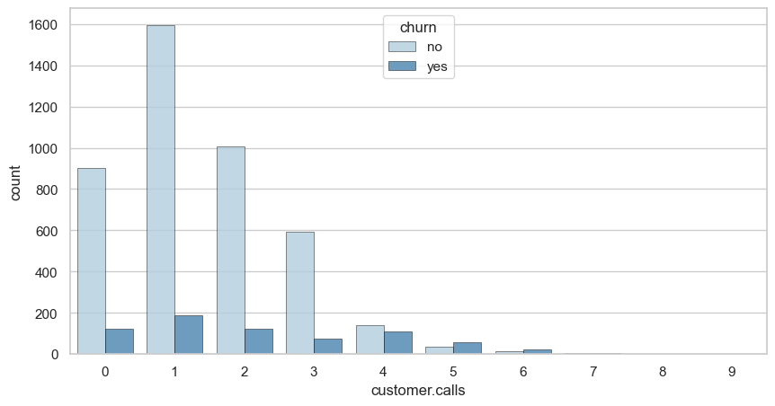
Whenever there are more customer calls the churn rates are higher, there are more then 300-350 unsatisfied customers who have called more than once.
From the above graph, we can observe that churn is directly proportional to customer calls. That is, churn is increasing with increase in customer service calls.

Slide 12
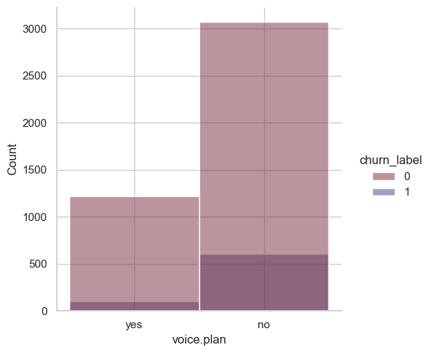
Percentage for churn rate for customer where they have purchased voice plan is 7.71 %
Percentage for churn rate for customer where they have not purchased voice plan is 16.45 %
From the above calculation we can infer that, churn rate is higher for the customer who have not purchased the voice plan

Slide 13
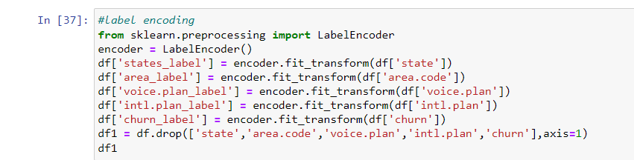
Data Preprocessing
For data preprocessing we have used LabelEncoder to convert our categorical columns (state, area.code, voice.plan, intl.plan and churn) to numerical dtype from object dtype.

Slide 14
Outlier Handling:
Before detecting for outliers we excluded the rows in which the customer churn was yes as it is an imbalanced dataset and the datapoints containing churn yes are very low compared to churn no.

Slide 15
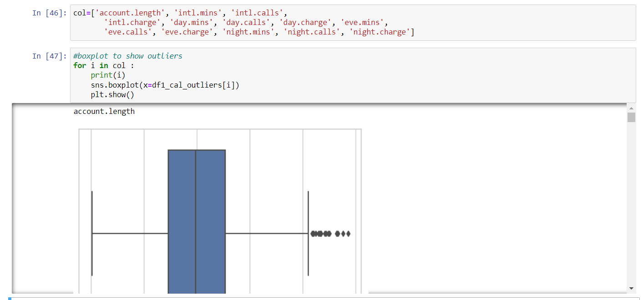
Here’s a snippet of the outlier detection code we used for visualization

Slide 16
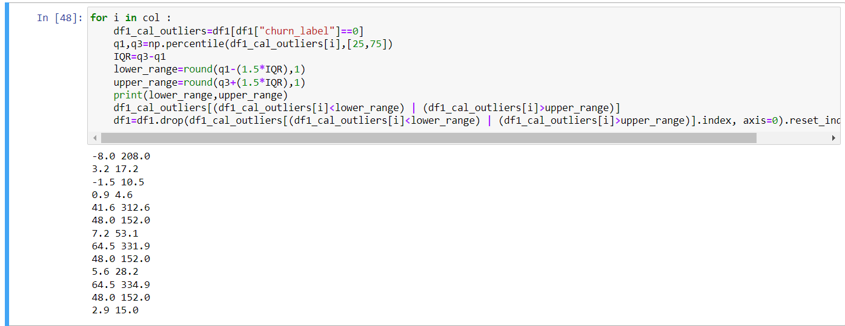
We used the IQR method for removing of the outliers. After outlier removal the shape of dataset was reduced to 4632 (368 outliers were present)

Slide 17
Feature Selection:
For feature selection we used two methods:
Pearson correlation method
Chi-square method

Slide 18
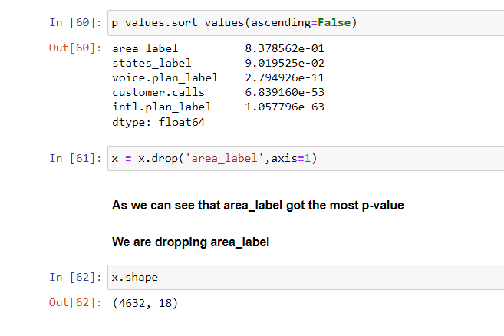
Chi Square Method:
After applying chi square method on all the categorical features from the dataset we found out that area.code has the highest p-value and hence we dropped area.code feature.

Slide 19
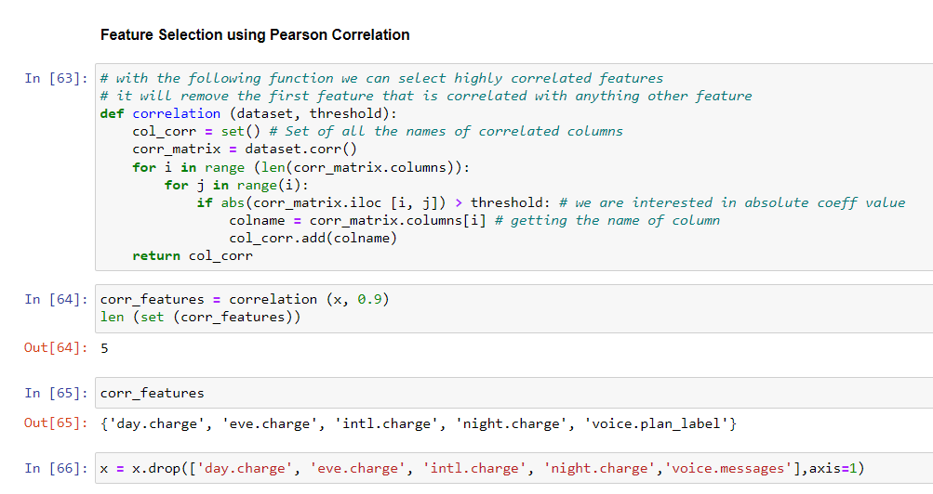
Pearson Correlation Method:

Slide 20
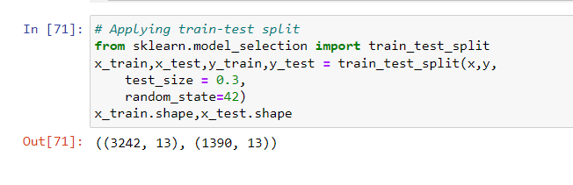
After applying train-test split the final shape we got:

Slide 21
Model Building:
As the target variable is categorical the models we used for prediction are:

Slide 22
We have built the following 6 models: Logistic Regression Knn Random Forest Decision trees Naïve Bayes XGBoost
As the data is imbalanced we have additionally used the following three methods to balance the data:
Undersampling
Oversampling
smotek

Slide 23
Model Evaluation
For model evaluation we are using the f1-score(Harmonic mean of precision and recall) metric as the data is imbalanced

Slide 24
Final Model
The final model we selected is XGBoost model as it was having best score compared to other models
Results for Xgboost model after tuning with parameters:
Train Accuracy: 97%
Test Accuracy: 96%

Slide 25
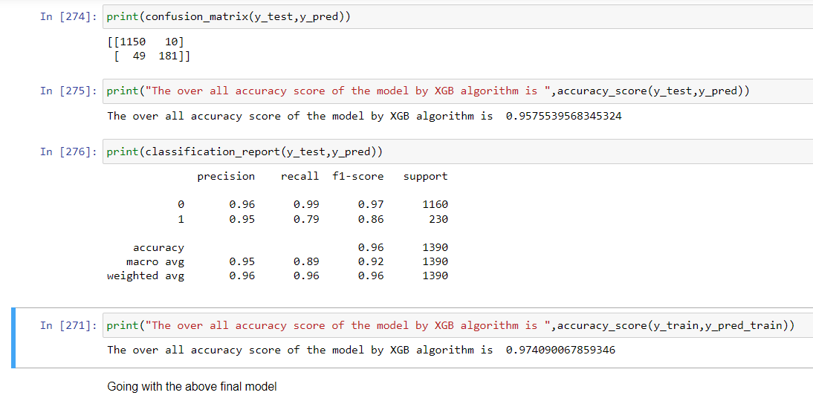
Here are the results for the final Model.

Slide 26
Model Deployment

Slide 27
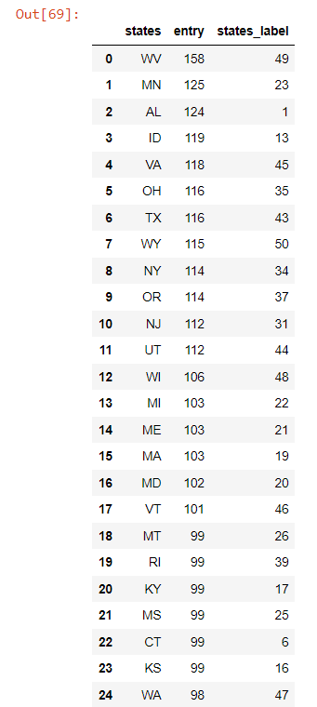
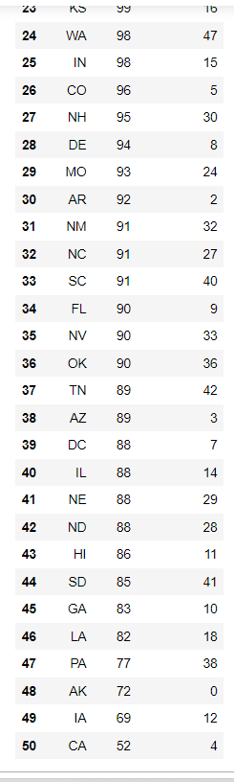
Identity of States used in deployment

Slide 28
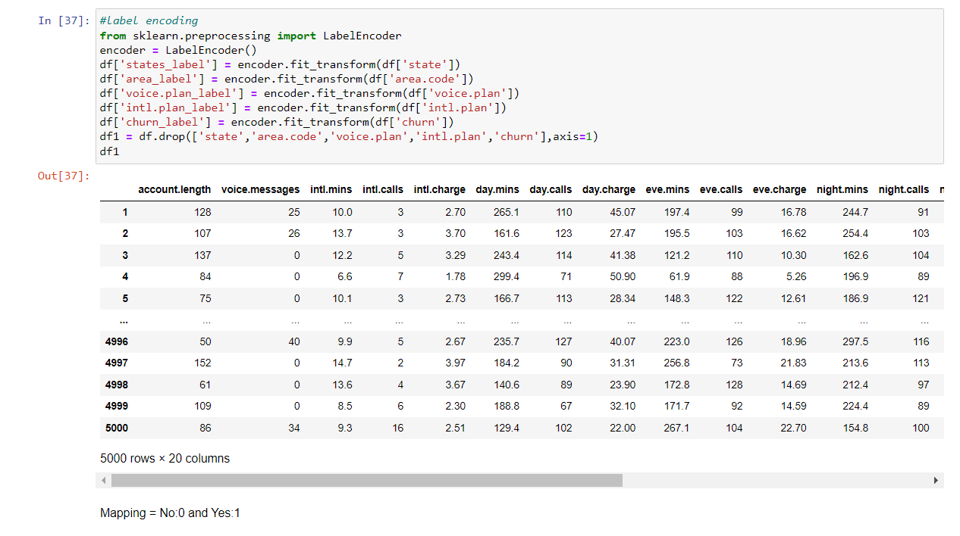
Mapping

Slide 29
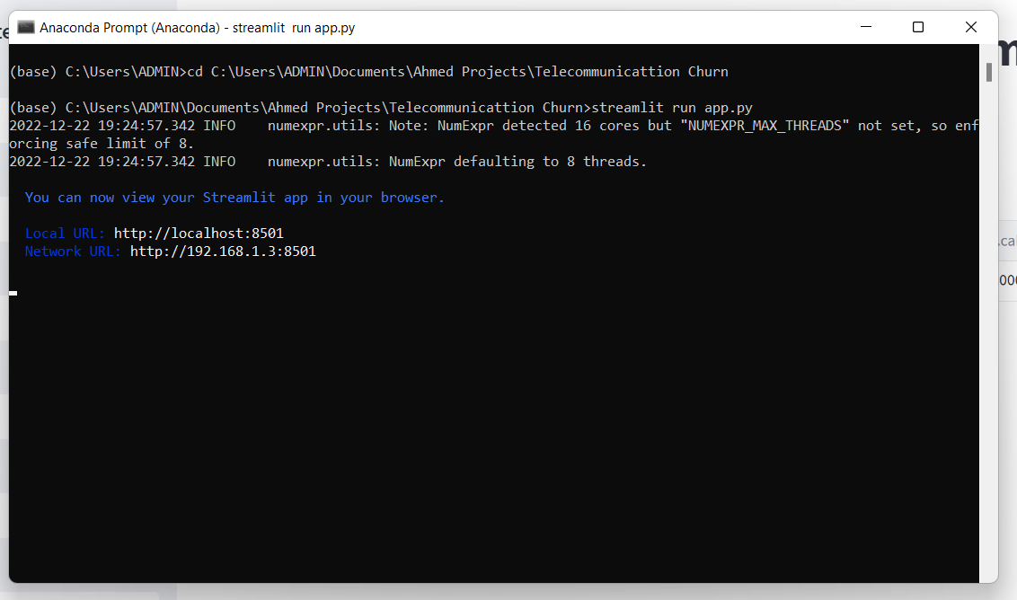
Model Deployment using Streamlit

Slide 30
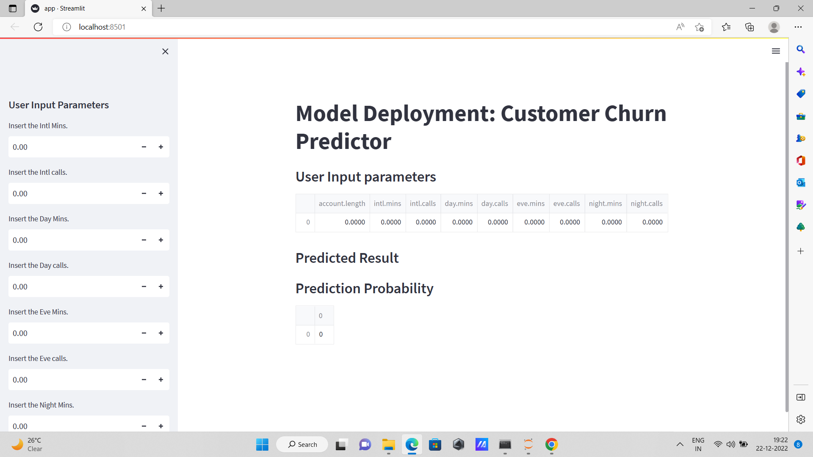
Deployment Interface

Slide 31
Validating Deployment
Following are the results for the mentioned index numbers below from the dataset which comes out to be correct.
16
4992
4999

Slide 32
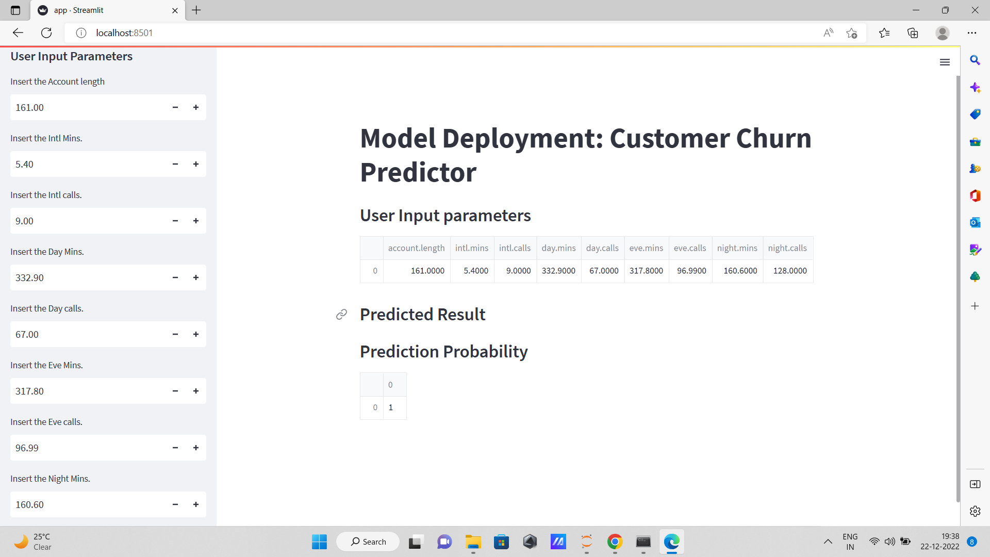

Slide 33
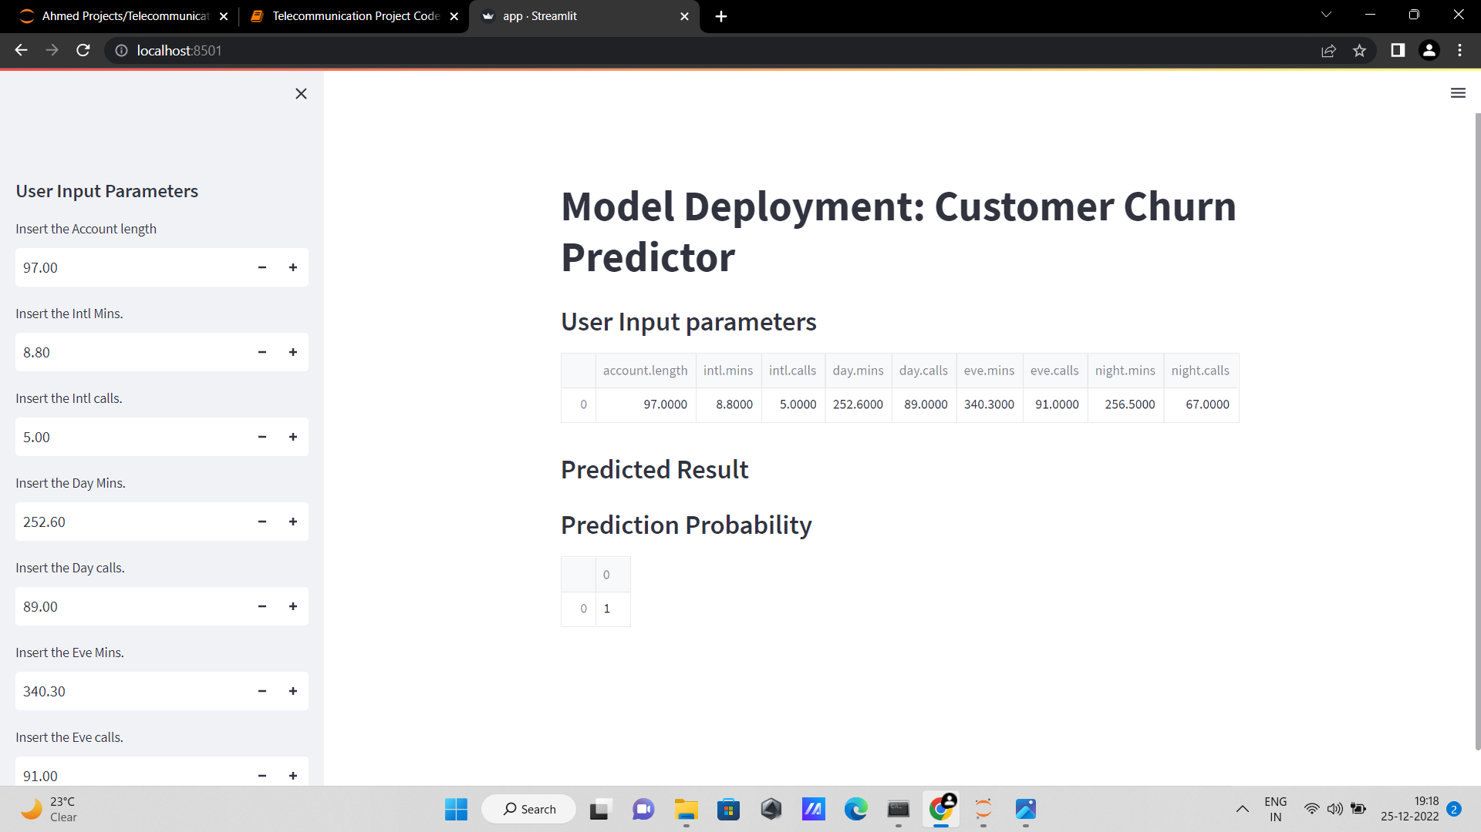

Slide 34
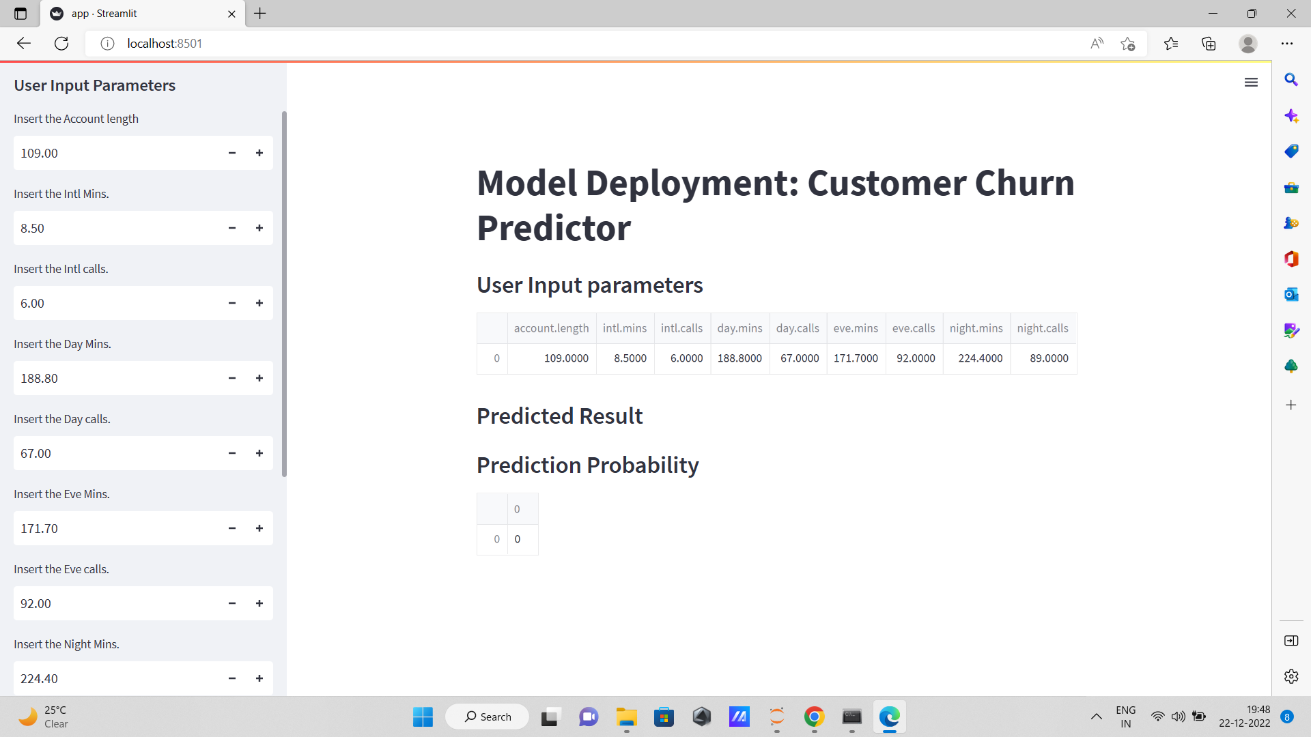

Slide 35
THANK YOU.

